Slide 1

Computer Vision
Naeemullah Khan
naeemullah.khan@kaust.edu.sa
KAUST Academy
King Abdullah University of Science and Technology
November 19, 2023
Computer Vision

Slide 2
Computer Vision
Building artificial systems that process, perceive, and reason about visual data
Computer Vision

Slide 3
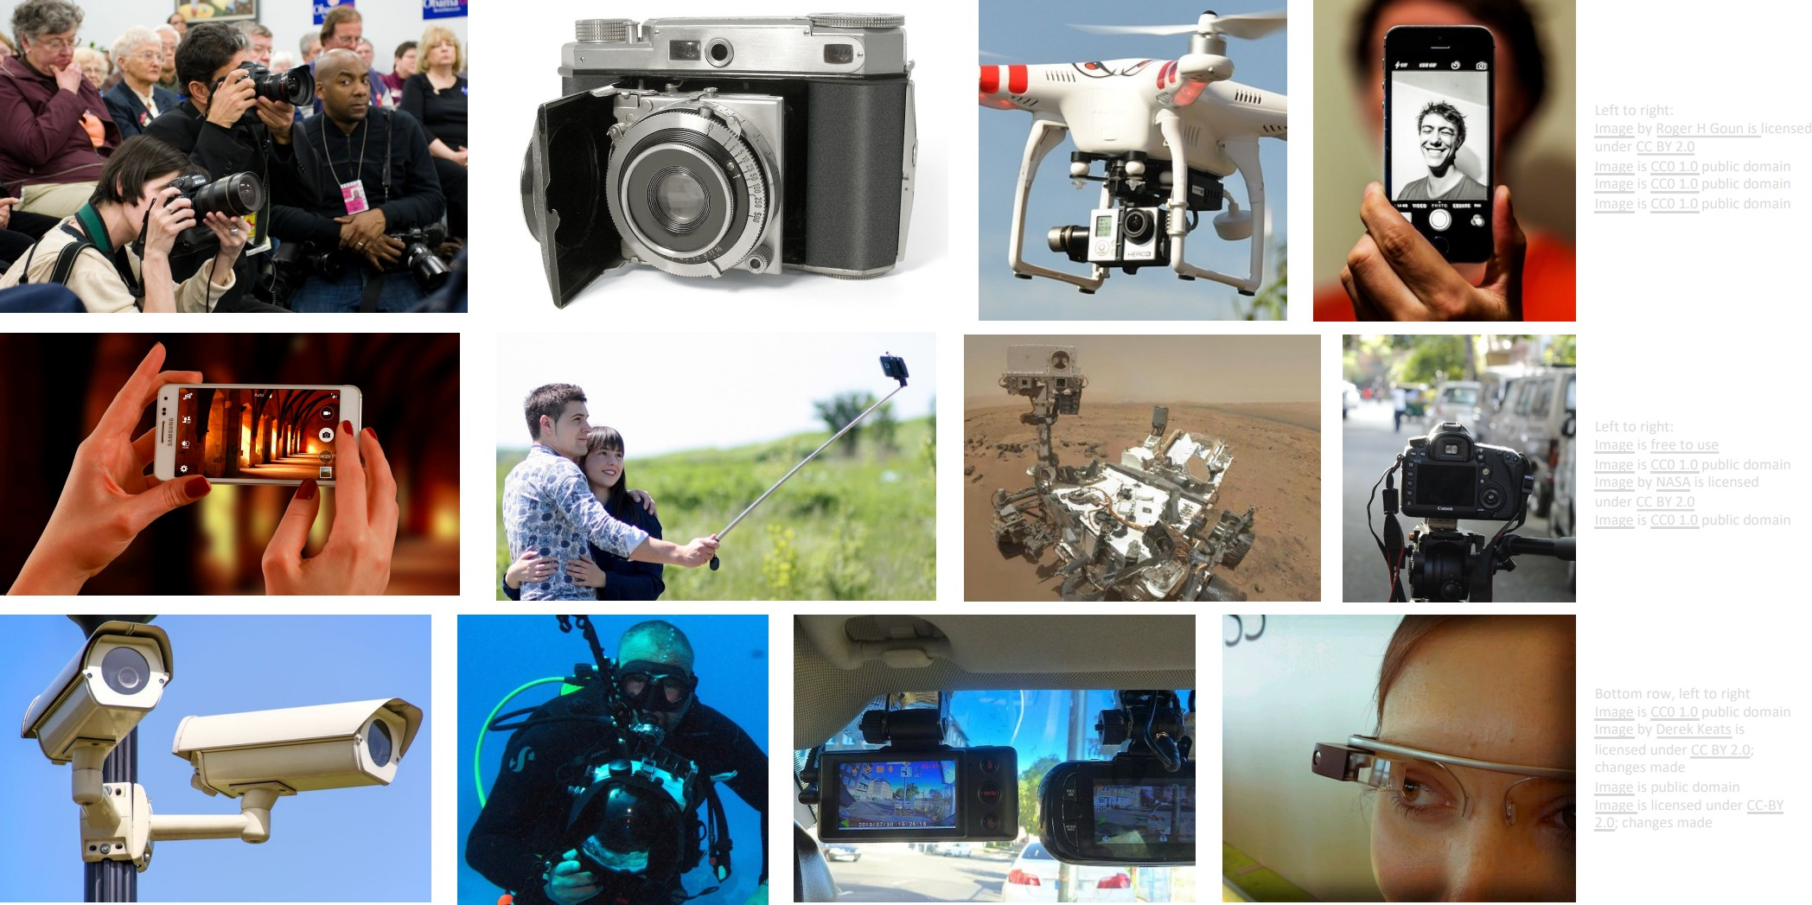
Computer Vision is Everywhere
Computer Vision

Slide 4
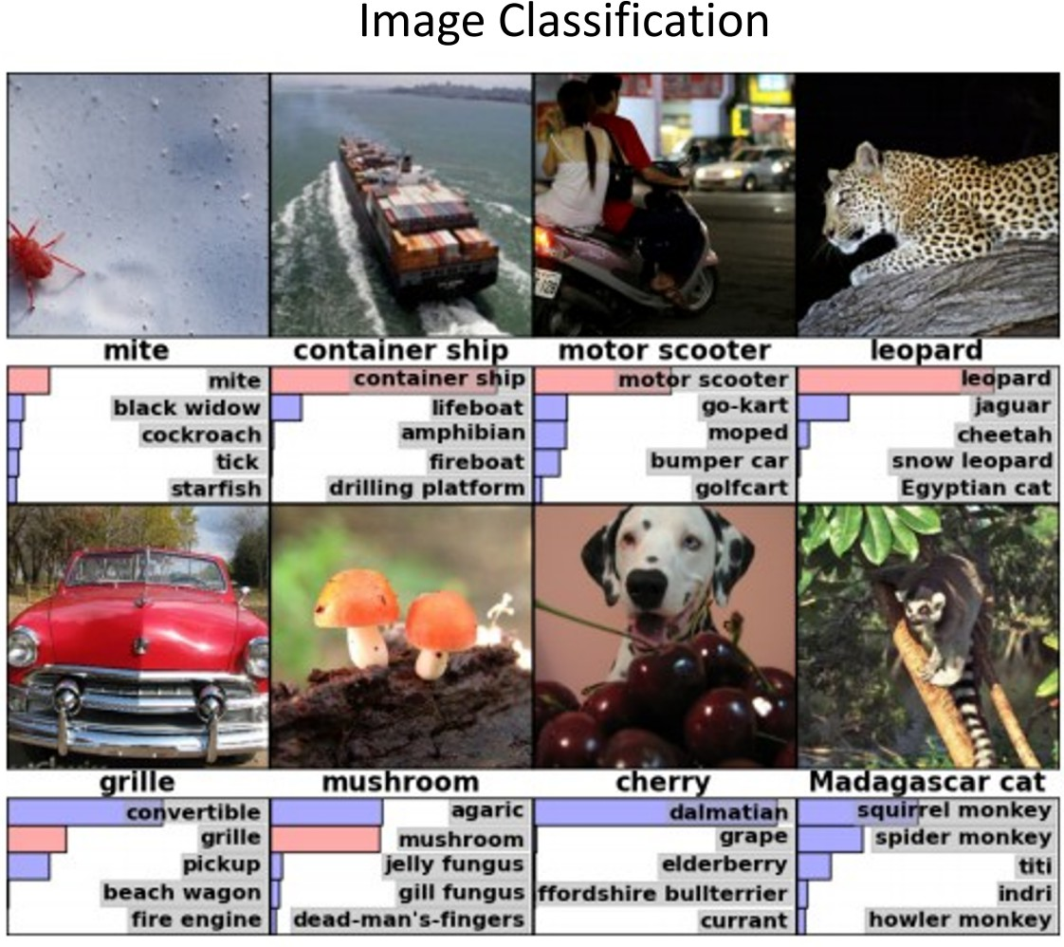
Some Applications
Computer Vision

Slide 5
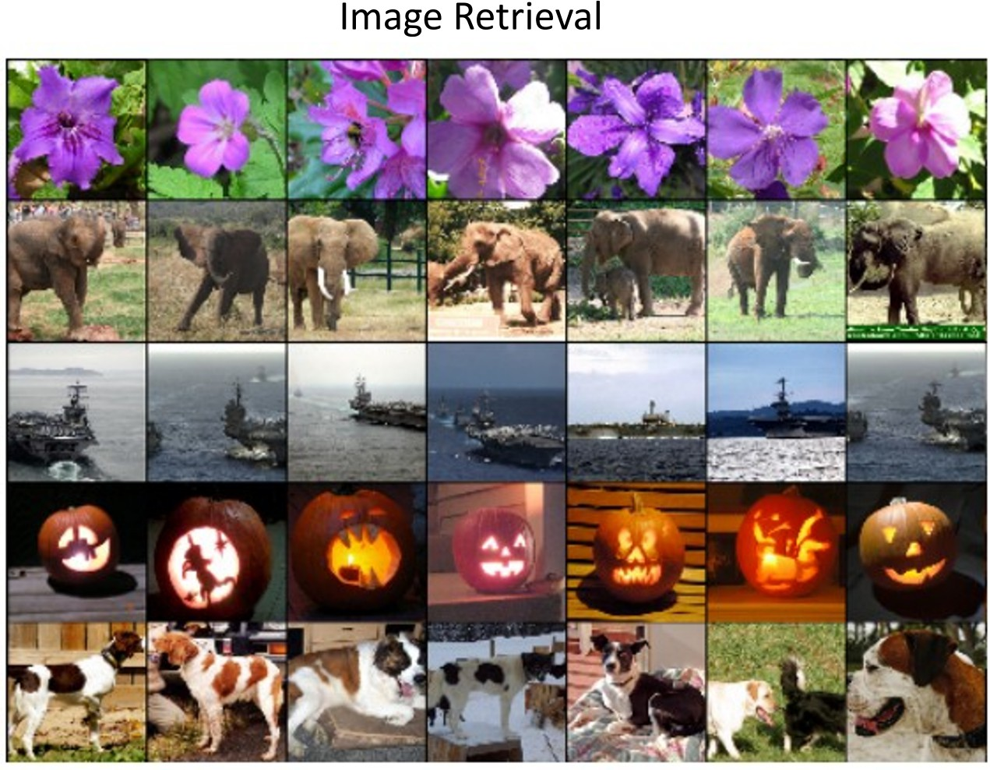
Some Applications (cont.)
Computer Vision

Slide 6
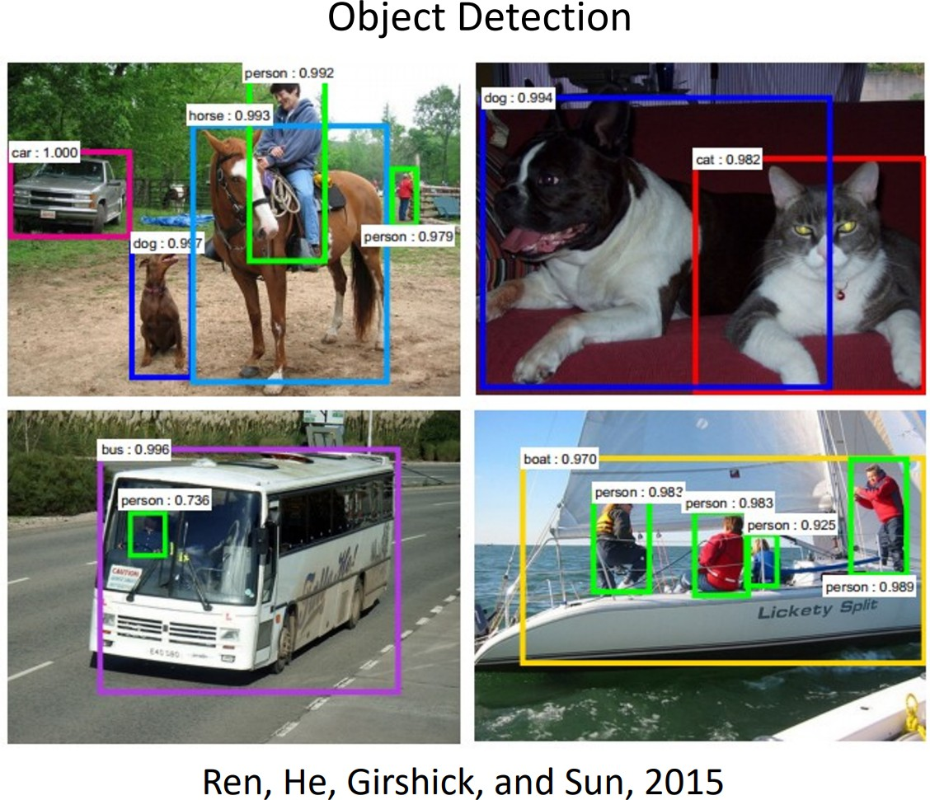
Some Applications (cont.)
Computer Vision

Slide 7
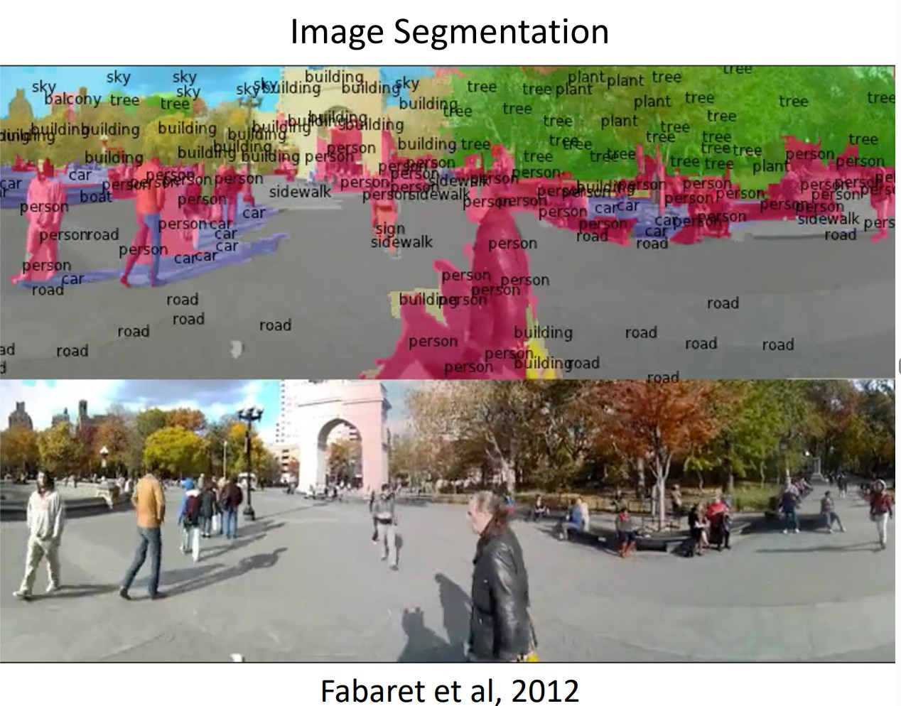
Some Applications (cont.)
Computer Vision

Slide 8
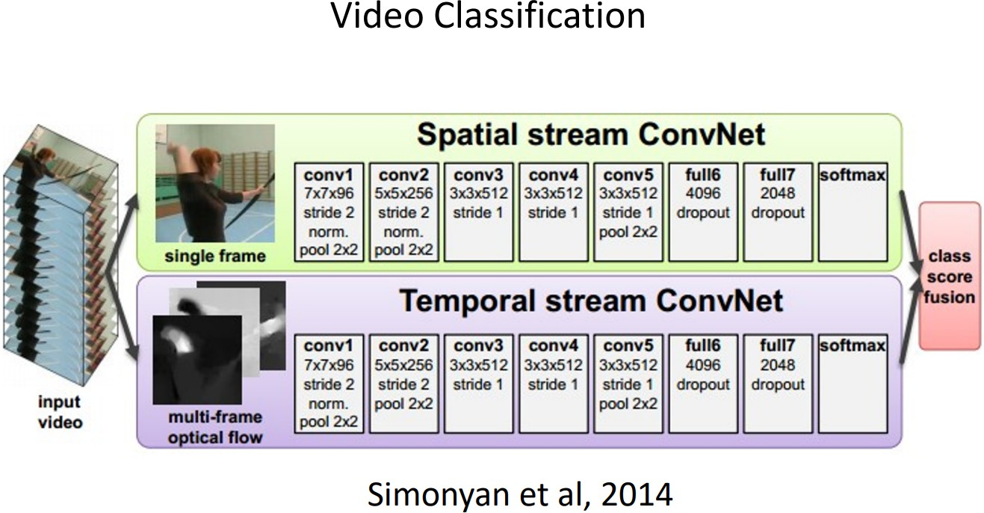
Some Applications (cont.)
Computer Vision

Slide 9
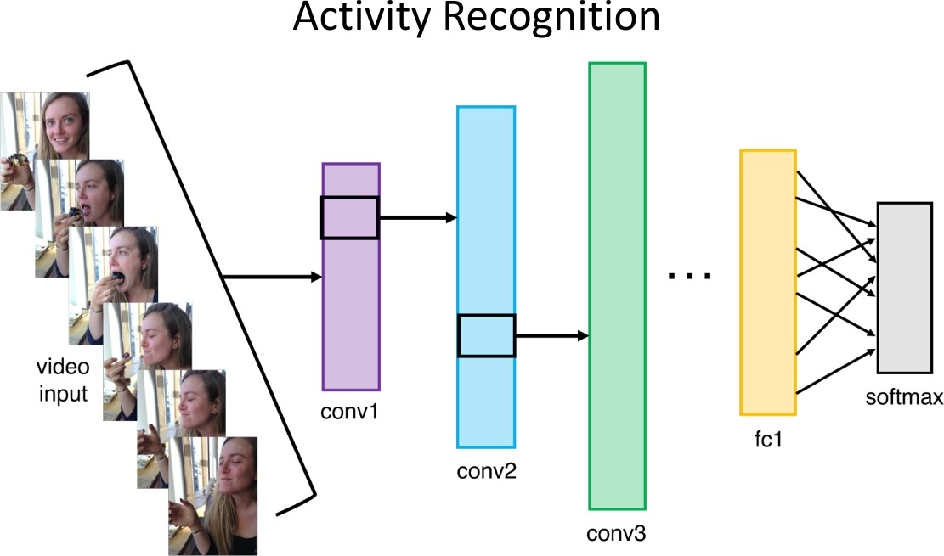
Some Applications (cont.)
Computer Vision

Slide 10
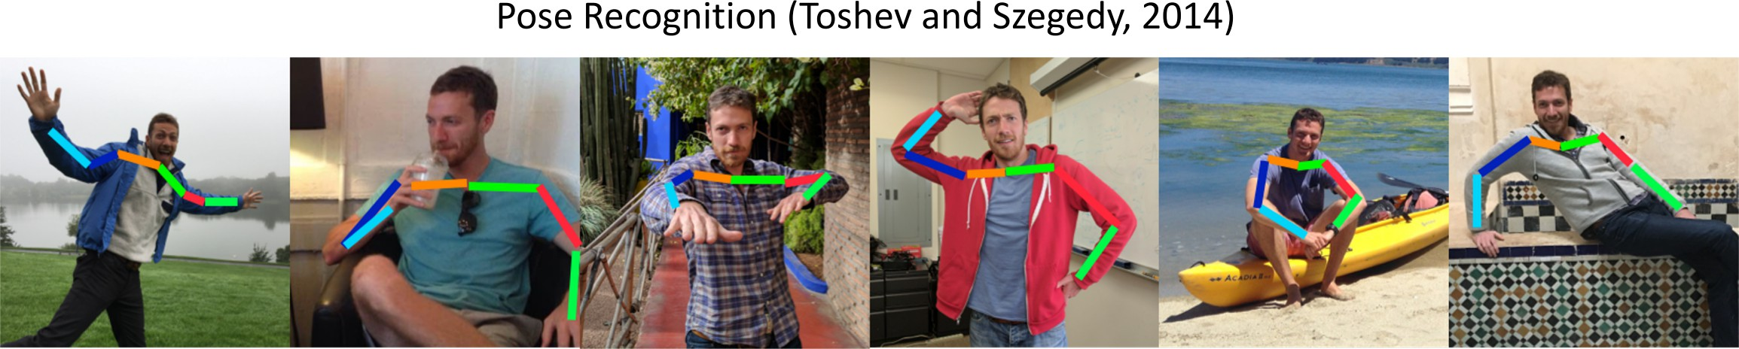
Some Applications (cont.)
Computer Vision

Slide 11
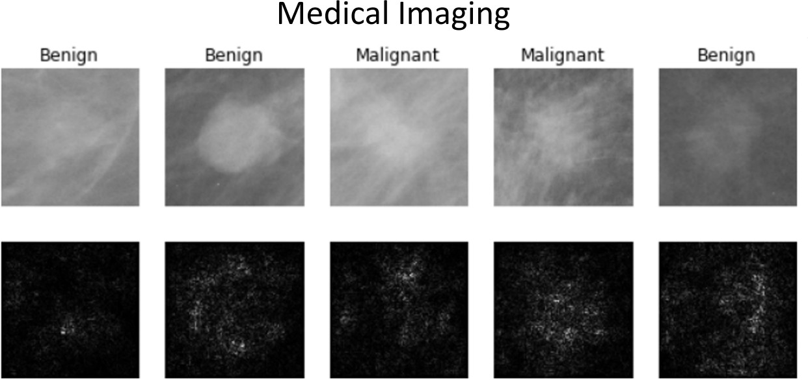
Some Applications (cont.)
Computer Vision

Slide 12
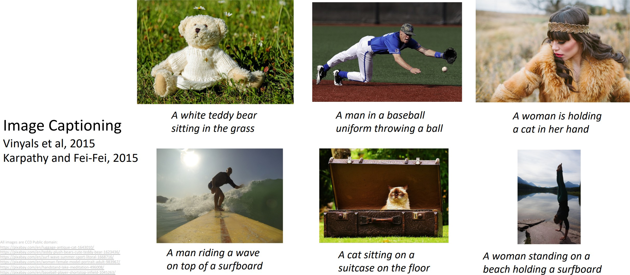
Some Applications (cont.)
Computer Vision

Slide 13
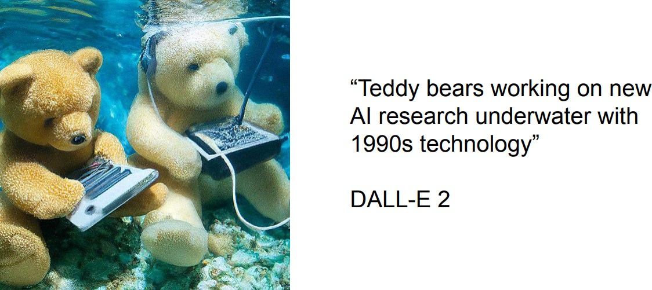
Some Applications (cont.)
Image Generation
Computer Vision

Slide 14
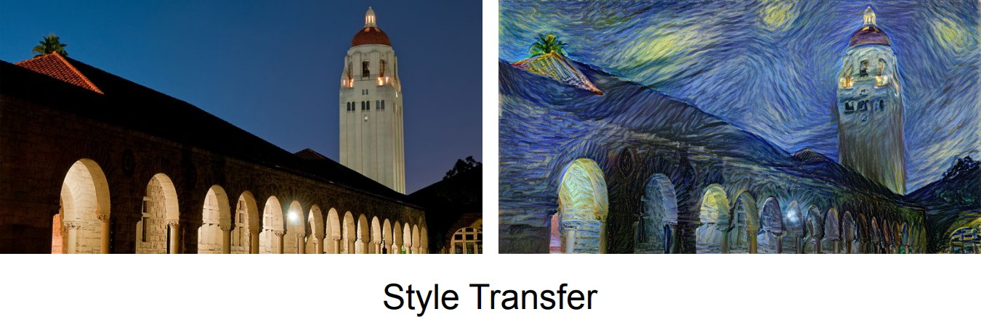
Some Applications (cont.)
Computer Vision

Slide 15
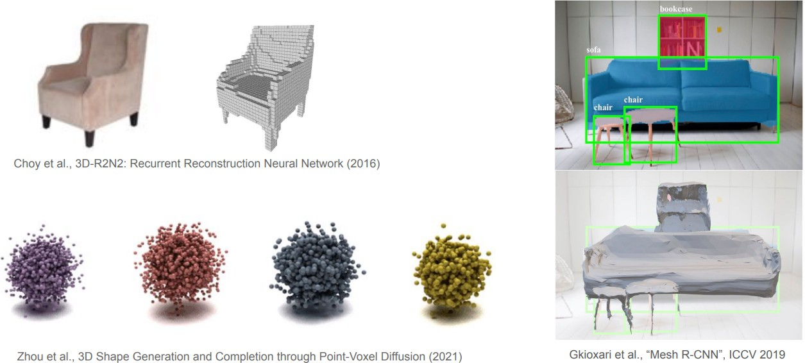
Some Applications (cont.)
3D Vision
Computer Vision

Slide 16
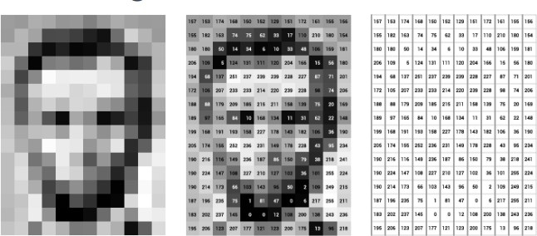
How to represent an image?
Images are represented as Matrices with elements in [0, 255]
Grayscale images have one channel while RGB images have 3 channels
⁰https://www.v7labs.com/blog/image-recognition-guide
Computer Vision

Slide 17

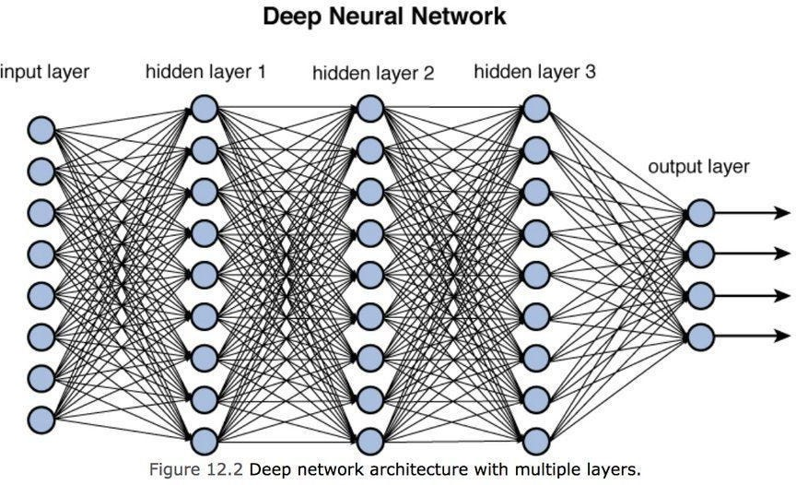
Fully-Connected Neural Networks
z = W₁x₁ + W₂x₂ + · · · + W_{n}x_{n} + b
⁰https://towardsdatascience.com/training-deep-neural-networks-9fdb1964b964
Computer Vision

Slide 18
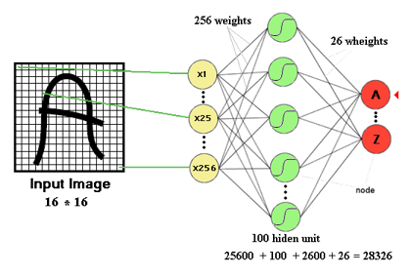
Drawbacks of Fully-Connected Neural Networks
The number of trainable parameters becomes extremely large
Computer Vision

Slide 19
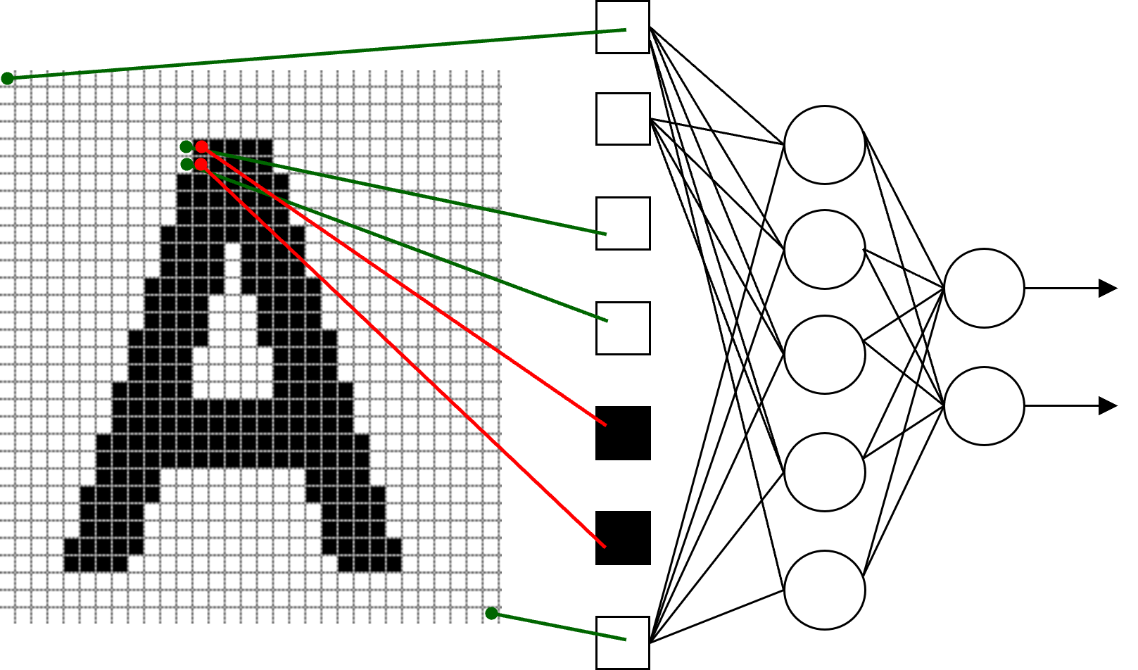
Drawbacks of Fully-Connected Neural Networks (cont.)
Little or no invariance to shifting, scaling, and other forms of distortion
Computer Vision

Slide 20
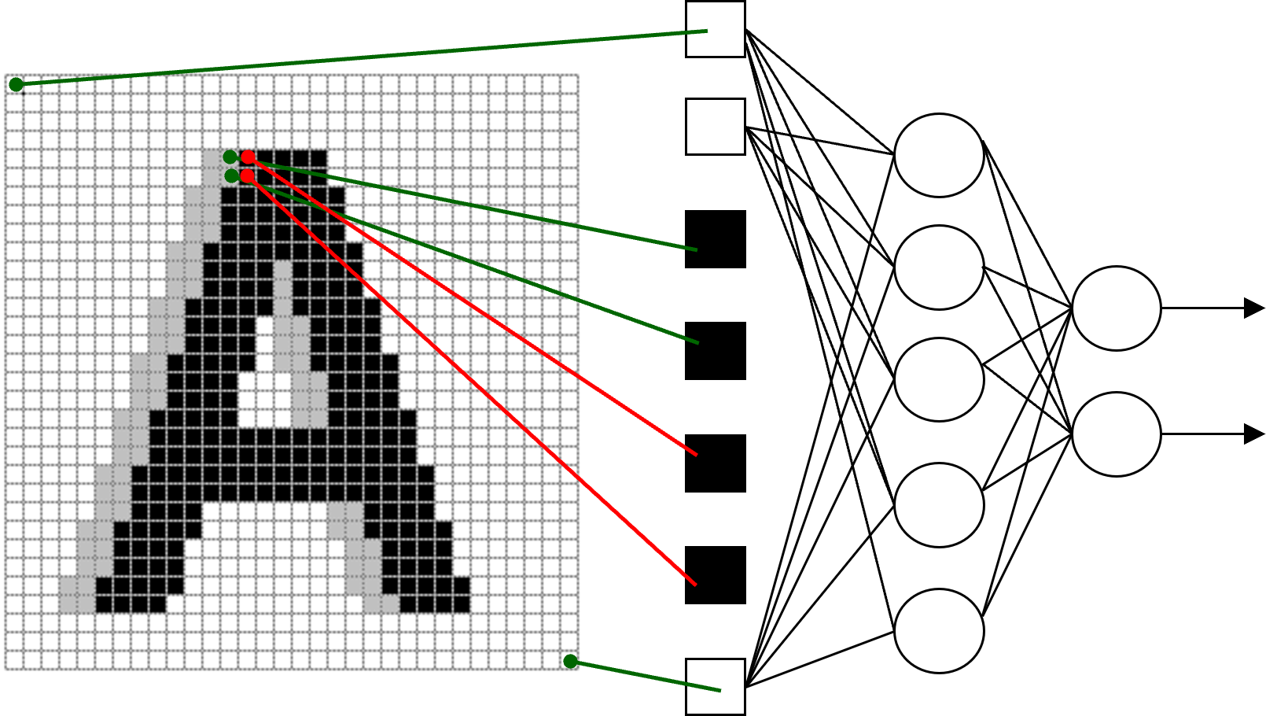
Drawbacks of Fully-Connected Neural Networks (cont.)
Little or no invariance to shifting, scaling, and other forms of distortion
Computer Vision

Slide 21
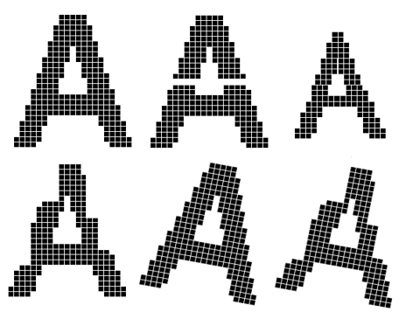
Drawbacks of Fully-Connected Neural Networks (cont.)
The topology of the input data is completely ignored
For a 32 × 32 image, we have
Black and white patterns: 2^{32∗32} = 2¹⁰²⁴
Grayscale patterns: 256^{32∗32} = 256¹⁰²⁴
Computer Vision

Slide 22
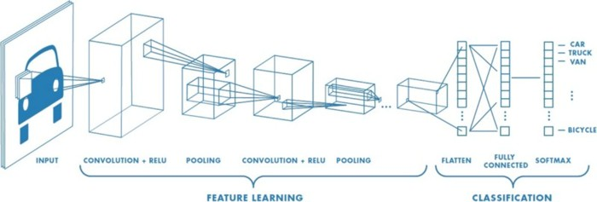
Convolutional Neural Networks (CNNs)
m−1 n−1
z = W ∗ x =
Σ Σ
a=0 b=0
W x
i,j
ab (i+a)(j+b)
Computer Vision

Slide 23
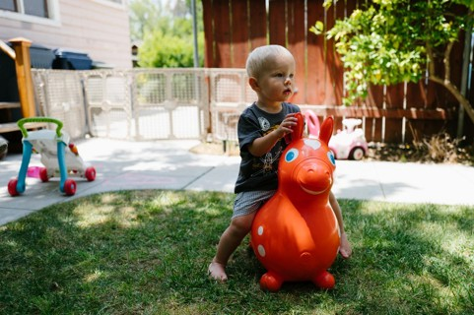
How Convolution Works?
Computer Vision

Slide 24
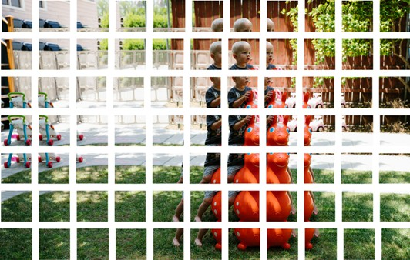
How Convolution Works? (cont.)
Computer Vision

Slide 25
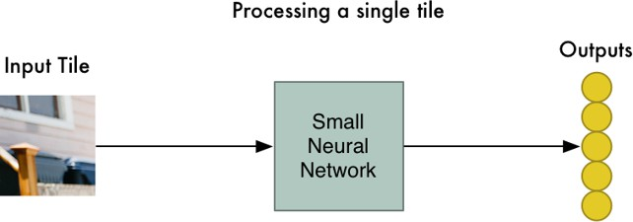
How Convolution Works? (cont.)
Computer Vision

Slide 26
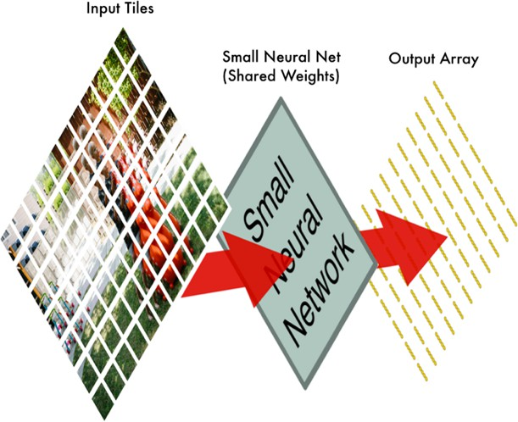
How Convolution Works? (cont.)
Computer Vision

Slide 27
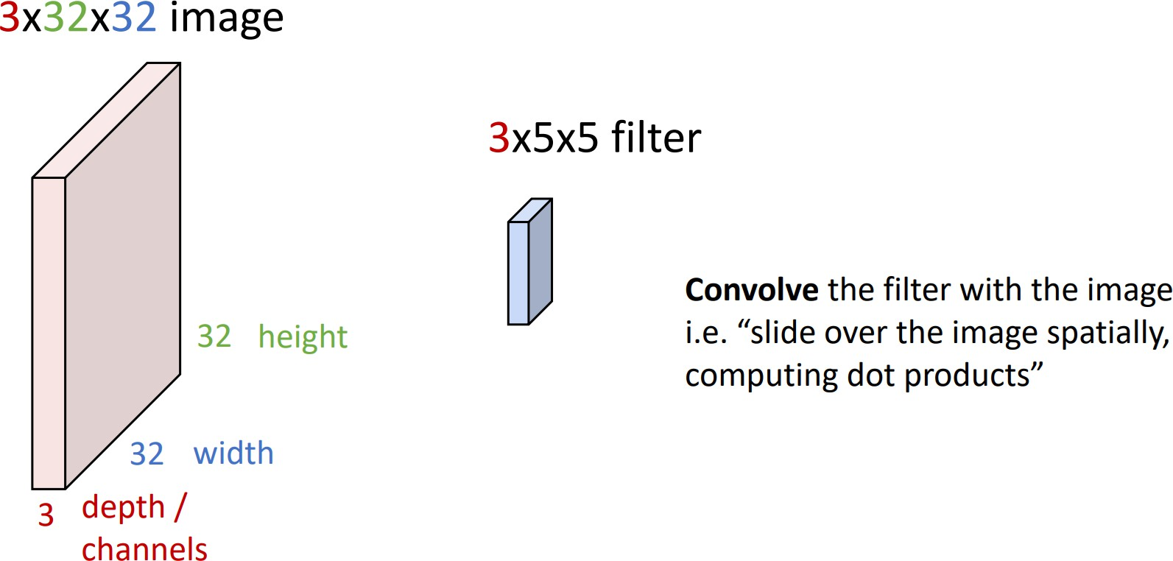
How Convolution Works? (cont.)
Computer Vision

Slide 28
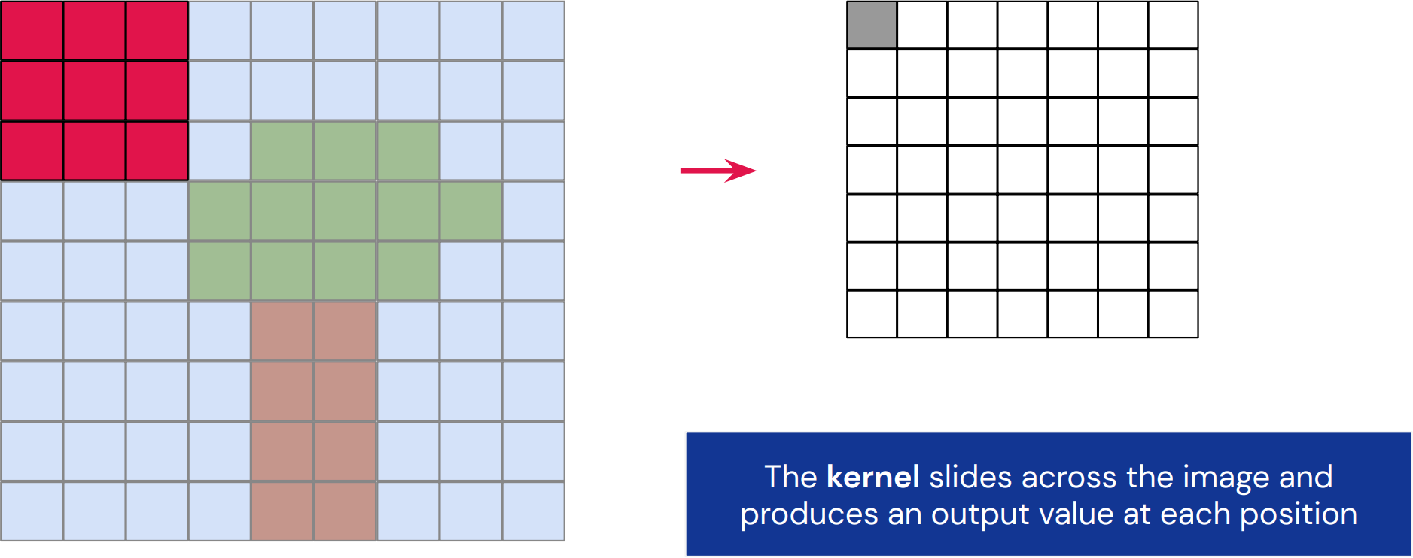
How Convolution Works? (cont.)
Computer Vision

Slide 29
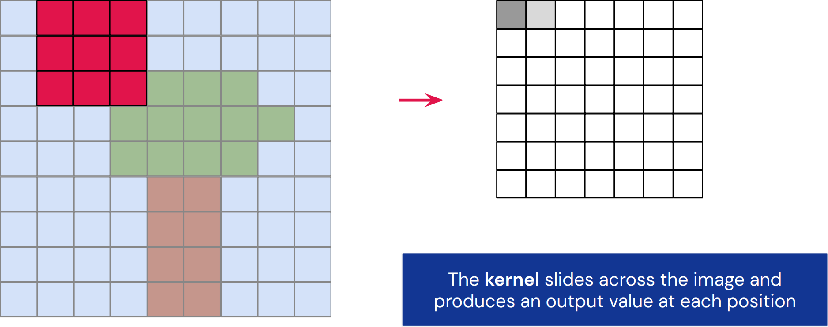
How Convolution Works? (cont.)
Computer Vision

Slide 30
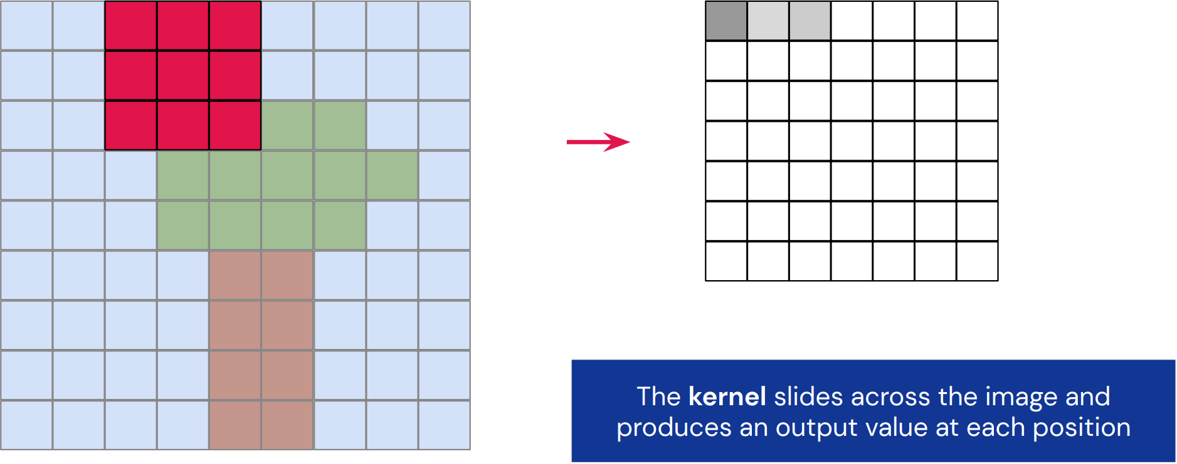
How Convolution Works? (cont.)
Computer Vision

Slide 31
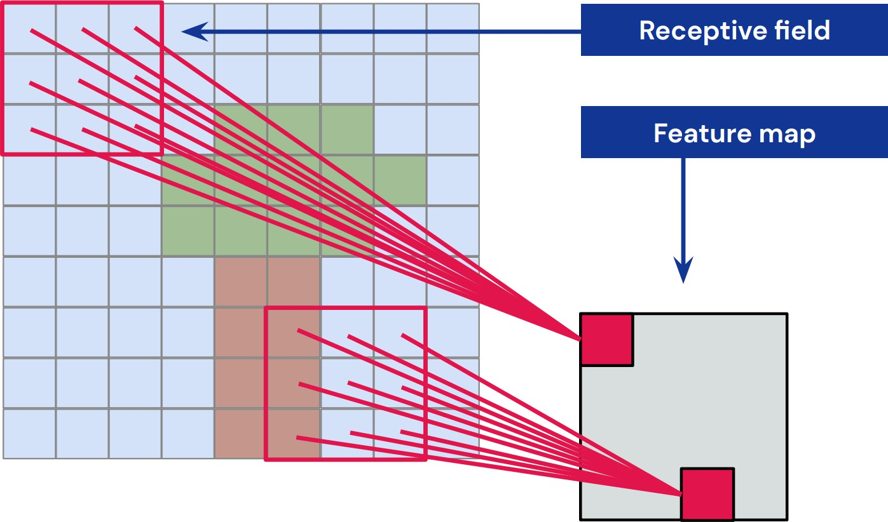
How Convolution Works? (cont.)
Computer Vision

Slide 32
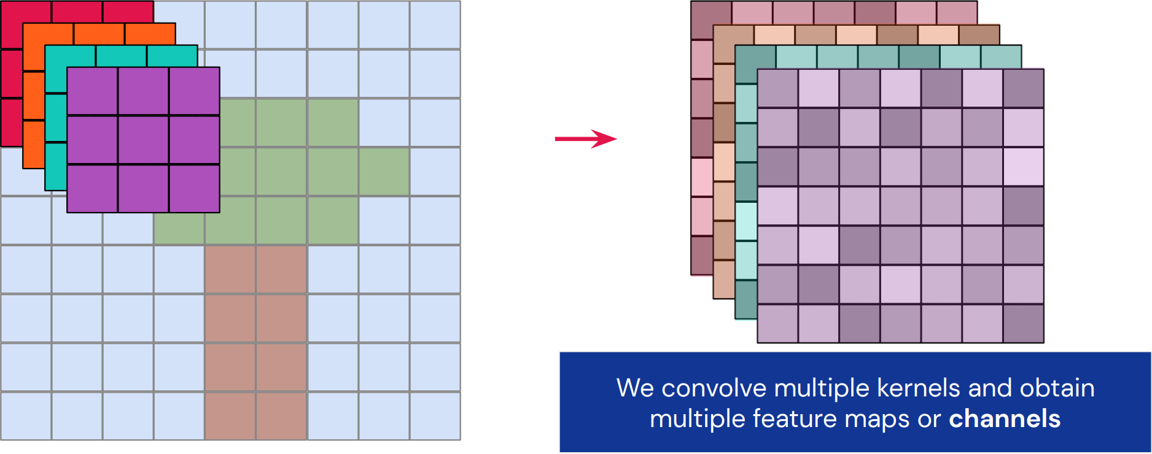
How Convolution Works? (cont.)
Computer Vision

Slide 33
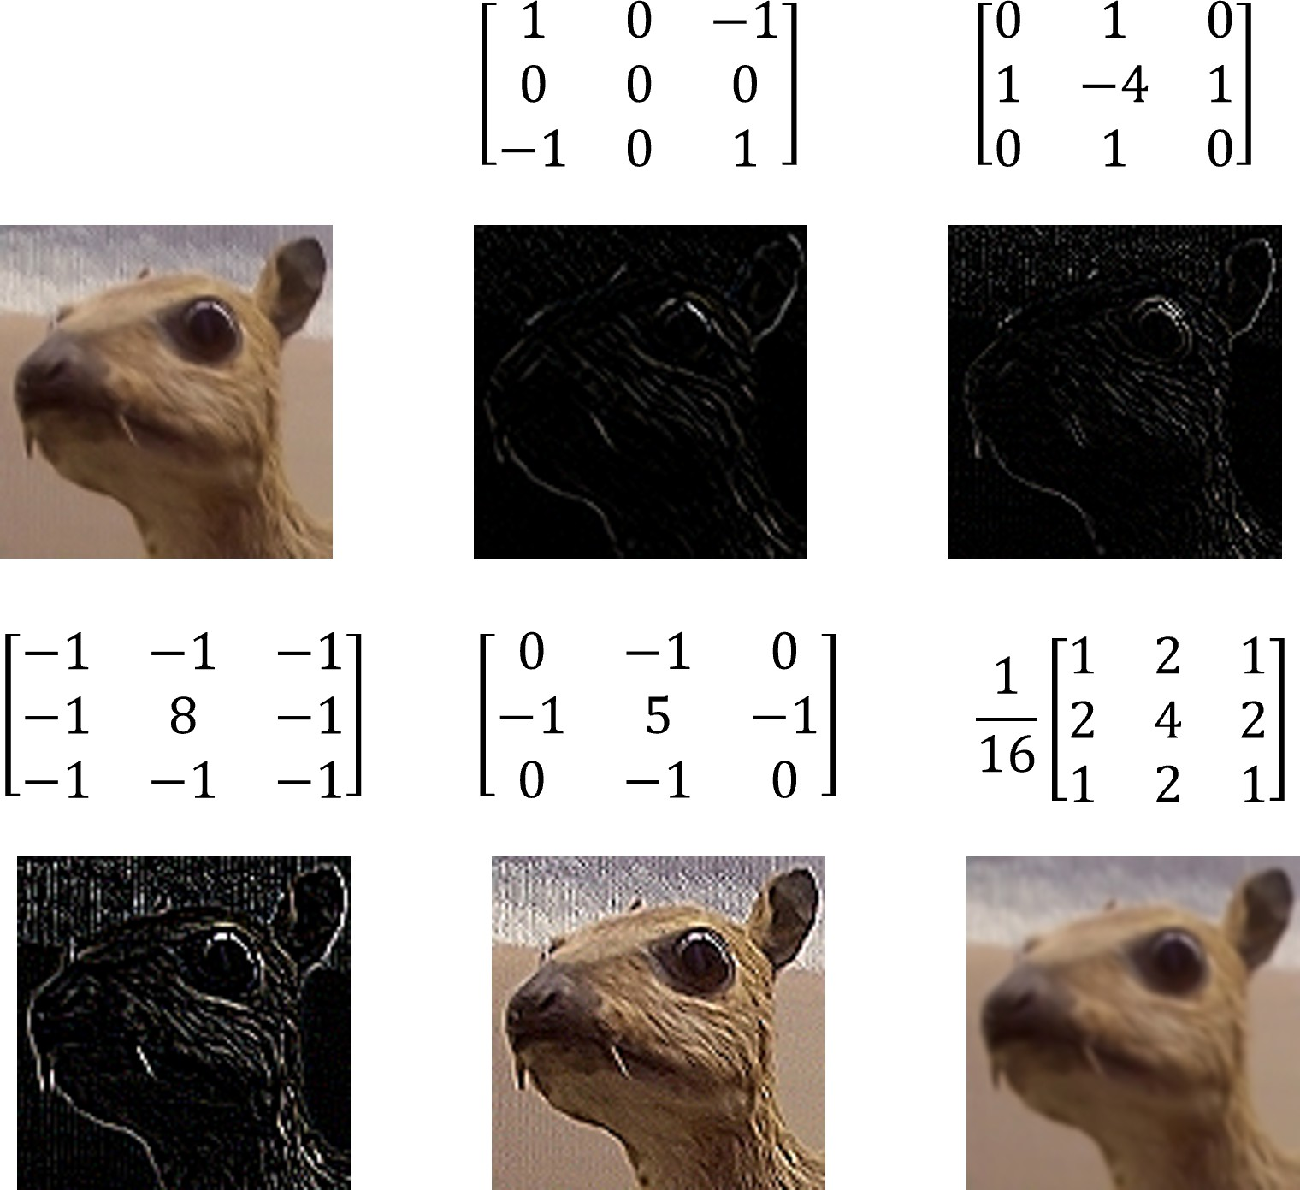
How Convolution Works? (cont.)
Computer Vision

Slide 34
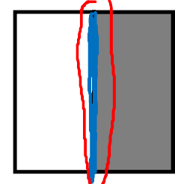
Vertical edge detection
Vertical edge detection
10 | 10 | 10 | 0 | 0 | 0
10 | 10 | 10 | 0 | 0 | 0
10 | 10 | 10 | 0 | 0 | 0
10 | 10 | 10 | 0 | 0 | 0
10 | 10 | 10 | 0 | 0 | 0
10 | 10 | 10 | 0 | 0 | 0
0 | 30 | 30 | 0
0 | 30 | 30 | 0
0 | 30 | 30 | 0
0 | 30 | 30 | 0
1 | 0 | -1
1 | 0 | -1
1 | 0 | -1
∗
=
∗

Slide 35
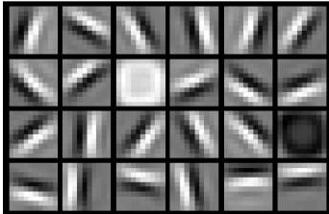
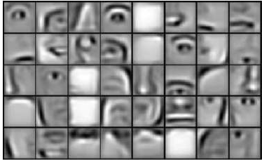
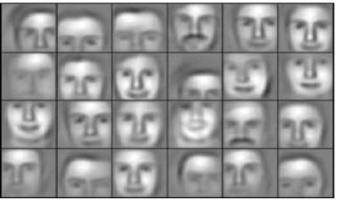
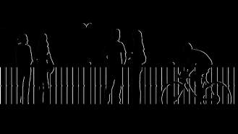
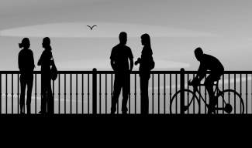
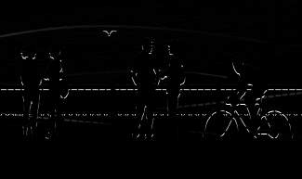
Edge detection example
vertical edges
horizontal edges

Slide 36
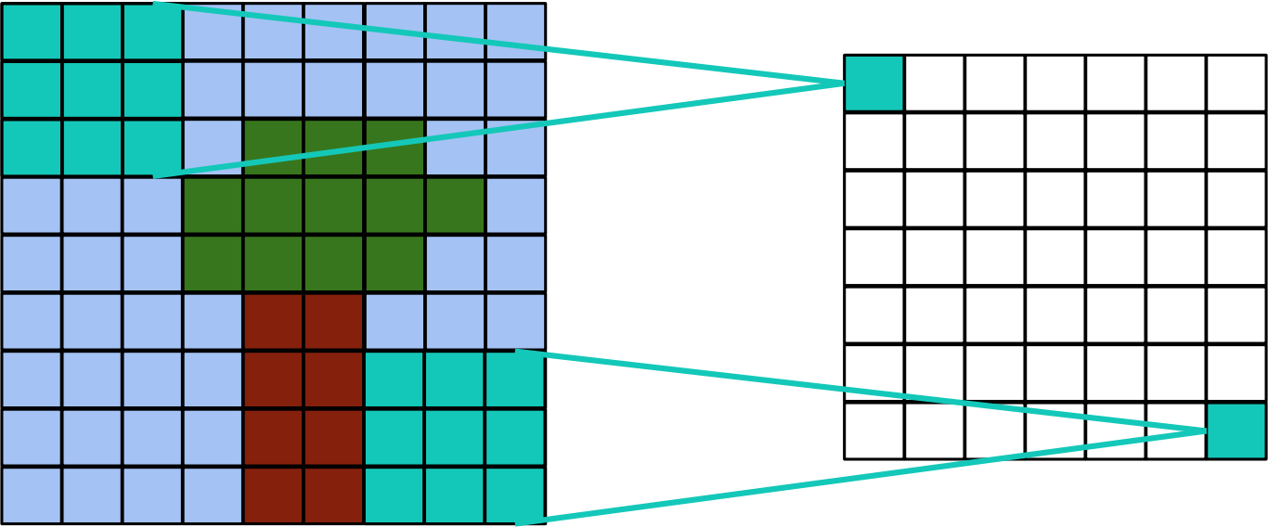
Padding
Applying Convolution as such reduces the size of the borders.
Sometimes this is not desirable.
We can pad the border with zeros.
Computer Vision

Slide 37
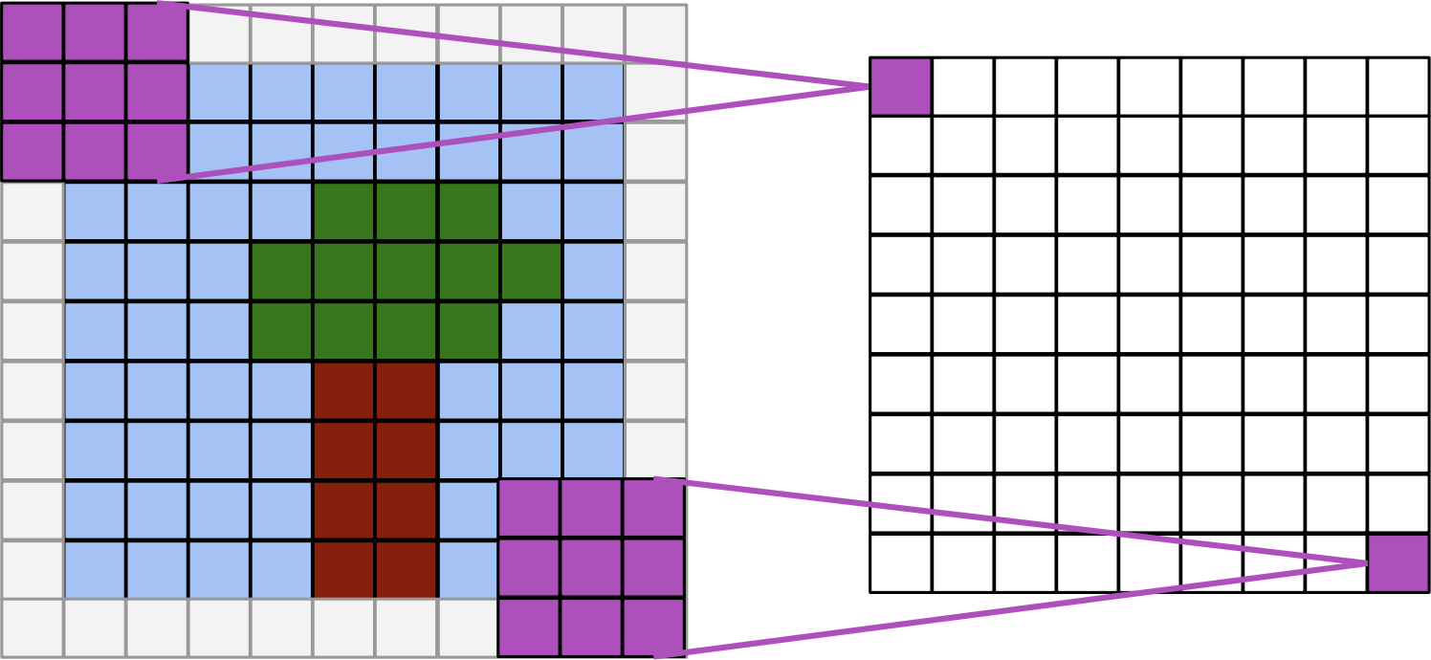
Padding (cont.)
Same Convolution: Output is the same size as input
Computer Vision

Slide 38
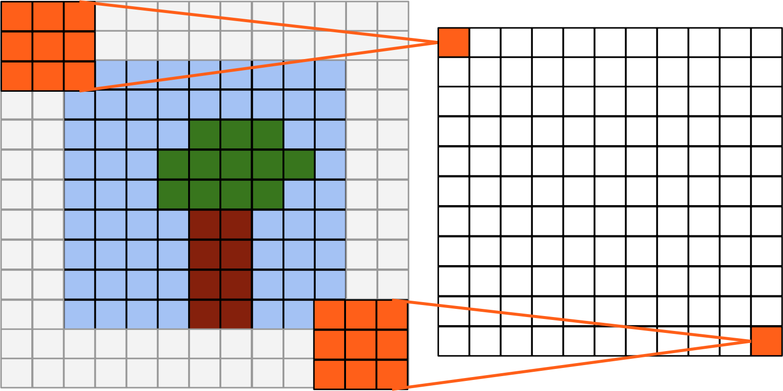
Padding (cont.)
Full Convolution: output size = input size + kernel size - 1
Computer Vision

Slide 39
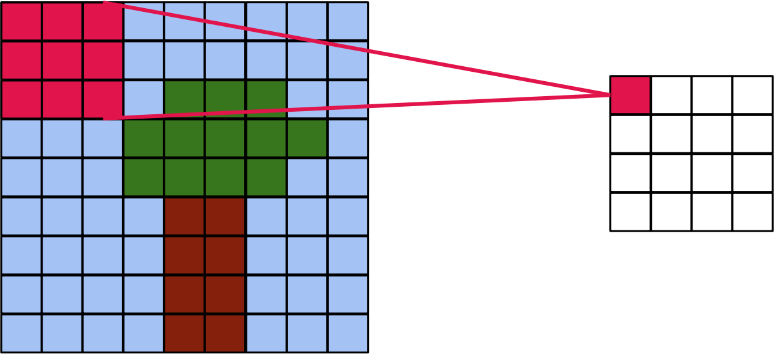
Strided Convolution
Kernel slides along the image with a step > 1
Computer Vision

Slide 40
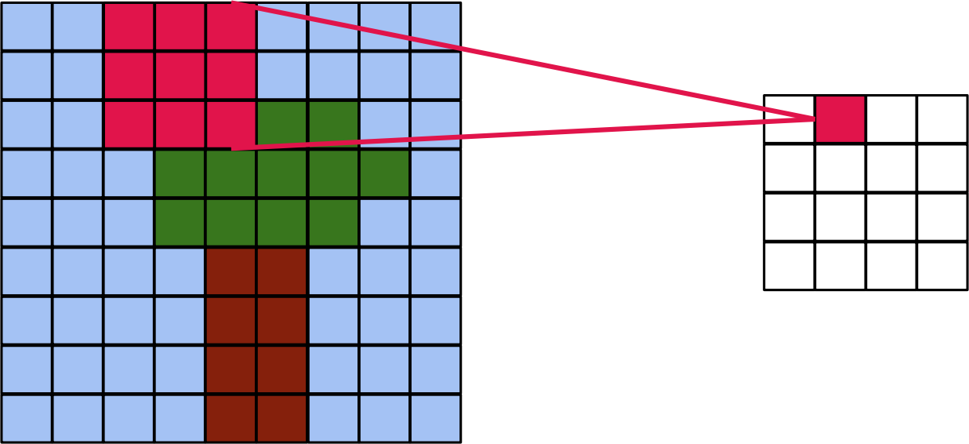
Strided Convolution (cont.)
Kernel slides along the image with a step > 1
Computer Vision

Slide 41
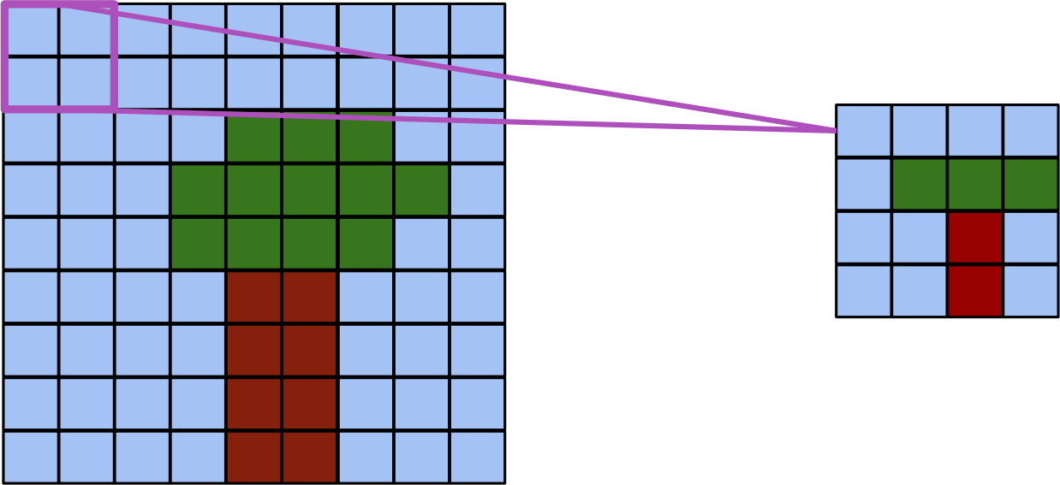
Pooling
Compute mean or max over small windows to reduce resolution
Computer Vision

Slide 42
Convolutions on RGB images
Convolutions on RGB images
∗
=
4 x 4

Slide 43
Multiple filters
∗
=
3 x 3 x 3
4 x 4
6 x 6 x 3
∗
=
3 x 3 x 3
4 x 4

Slide 44
Example of a conv layer
∗
3 x 3 x 3
∗
6 x 6 x 3
3 x 3 x 3

Slide 45
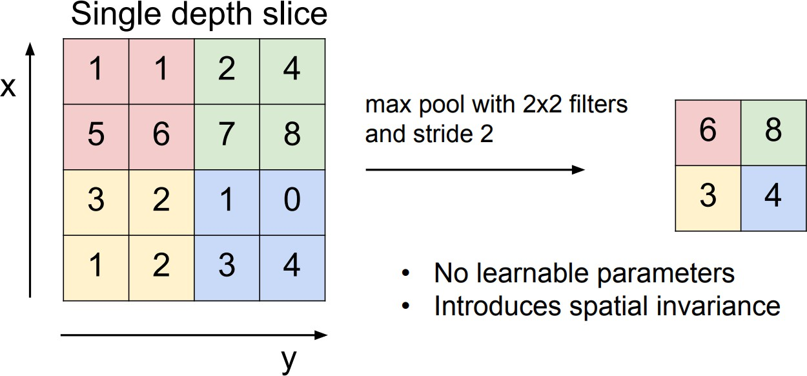
Pooling (cont.)
Computer Vision

Slide 46
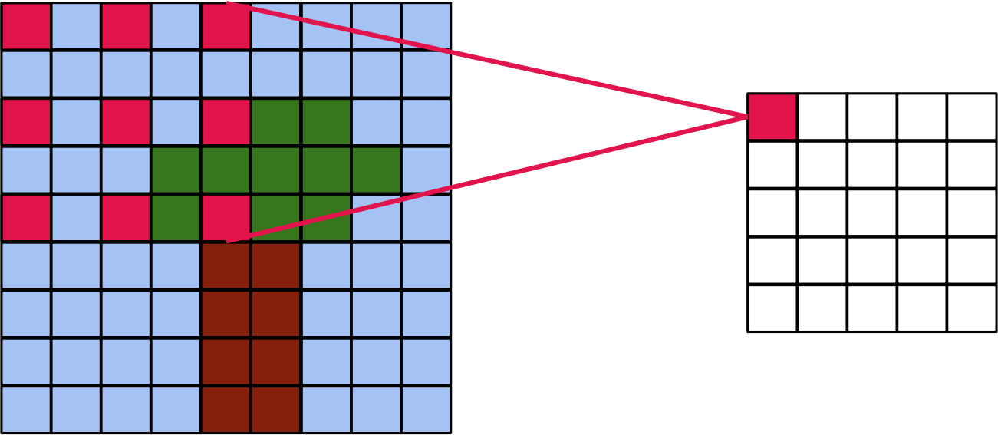
Dilated Convolution
Kernel is spread out, step > 1 between kernel elements
Computer Vision

Slide 47
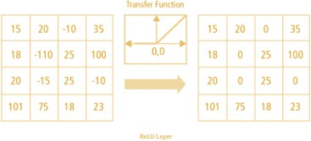
Activation
Just like Fully-Connected Neural Networks, we can apply an activation over convolutional layer outputs
It helps break linearity
For example, Rectified Linear Unit (ReLU): σ(x ) = max (0, x )
Computer Vision

Slide 48
Why convolutions
10 | 10 | 10 | 0 | 0 | 0
10 | 10 | 10 | 0 | 0 | 0
10 | 10 | 10 | 0 | 0 | 0
10 | 10 | 10 | 0 | 0 | 0
10 | 10 | 10 | 0 | 0 | 0
10 | 10 | 10 | 0 | 0 | 0
0 | 30 | 30 | 0
0 | 30 | 30 | 0
0 | 30 | 30 | 0
0 | 30 | 30 | 0
1 | 0 | -1
1 | 0 | -1
1 | 0 | -1
∗
=
Parameter sharing: A feature detector (such as a vertical edge detector) that’s useful in one part of the image is probably useful in another part of the image.
Sparsity of connections: In each layer, each output value depends only on a small number of inputs.

Slide 49
Convolutional Neural Networks
Computer Vision

Slide 50
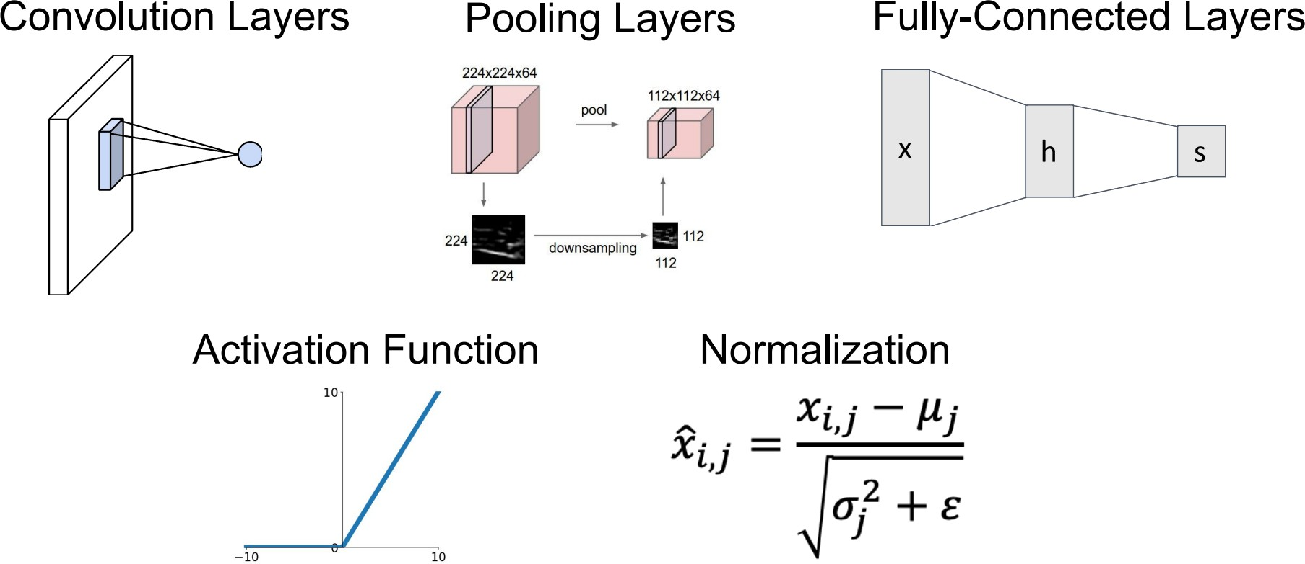
Components of a CNN
Computer Vision

Slide 51
Number of parameters
Number of parameters
If you have 10 filters that are 3 x 3 x 3 in one layer of a neural network, how many parameters does that layer have?

Slide 52
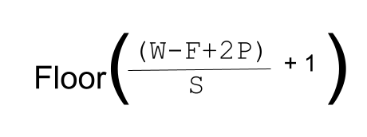
Number of parameters
Output Shape
https://androidkt.com/calculate-output-size-convolutional-pooling-layers-cnn/

Slide 53
Most Notable CNNs
LeNet
AlexNet [Krizhevsky et al. 2012]
VGGNet [Simonyan and Zisserman, 2014]
InceptionNet (GoogLeNet) [Szegedy et al., 2014]
ResNet [He et al., 2015]
MobileNet
Computer Vision

Slide 54
LeNet - 5
⋮
⋮
avg pool
avg pool
ŷ
5 × 5
s = 1
f = 2
s = 2
5 × 5
s = 1
f = 2
s = 2
32×32 ×1
28×28×6
14×14×6
10×10×16
5×5×16
120
84
[LeCun et al., 1998. Gradient-based learning applied to document recognition]

Slide 55
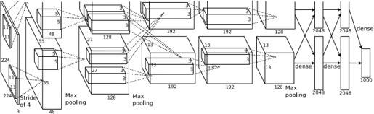
AlexNet
First big improvement in image classification
Made use of CNN, pooling, dropout, ReLU and training on GPUs.
5 convolutional layers, followed by max-pooling layers; with three fully connected layers at the end
Computer Vision

Slide 56
AlexNet
MAX-POOL
MAX-POOL
11 × 11
s = 4
3 × 3
s = 2
5 × 5
same
3 × 3
s = 2
55×55 ×96
27×27 ×96
27×27 ×256
13×13 ×256
227×227 ×3
⋮
⋮
⋮
MAX-POOL
=
3 × 3
same
13×13 ×384
3 × 3
3 × 3
3 × 3
s = 2
Softmax 1000
13×13 ×384
13×13 ×256
6×6 ×256
9216
4096
4096
[Krizhevsky et al., 2012. ImageNet classification with deep convolutional neural networks]

Slide 57

VGGNet
Stack of three 3x3 conv (stride 1) layers has same effective receptive field as one 7x7 conv layer
But deeper, more non-linearities and lesser parameters
13 or 16 conv layers with 3 fully-connected layers. Most params in the fully connected layer
Computer Vision

Slide 58

InceptionNet
Going Deep: 22 layers
Only 5 million parameters! (12x less than AlexNet and 27x less than VGGNet)
Introduced efficient ”Inception module”
Introduced ”bottleneck” layers that use 1x1 convolutions to reduce feature channel size and computational complexity
Computer Vision

Slide 59
Inception network
The problem of computational cost
CONV 5 × 5,
same, 32
28 × 28 × 32
28 × 28 × 192

Slide 60
Inception network
Using 1x1 convolution
CONV 1 × 1,
16,
1 × 1 × 192
CONV 5 × 5,
32,
5 × 5 × 16
28 × 28 × 16
28 × 28 × 32
28 × 28 × 192

Slide 61

InceptionNet (cont.)
Inception module: design a good local network topology (network within a network) and then stack these modules on top of each other
Computer Vision

Slide 62
Inception network
1 × 1
3 × 3
64
5 × 5
28
128
32
32
28
28 × 28 × 192
MAX-POOL
[Szegedy et al. 2014. Going deeper with convolutions]

Slide 63

ResNet
Very deep networks using residual connections
152-layer model for ImageNet
Stacked Residual Blocks
Computer Vision

Slide 64
ResNet
What happens when we continue stacking deeper layers on a ”plain” convolutional neural network?
Computer Vision

Slide 65

ResNet
What happens when we continue stacking deeper layers on a ”plain” convolutional neural network?
Computer Vision

Slide 66
ResNet
What happens when we continue stacking deeper layers on a ”plain” convolutional neural network?
56-layer model performs worse on both test and training error
Computer Vision

Slide 67
ResNet
What happens when we continue stacking deeper layers on a ”plain” convolutional neural network?
56-layer model performs worse on both test and training error
The deeper model performs worse, but it’s not caused by overfitting!
Computer Vision

Slide 68
ResNet
Fact: Deep models have more representation power (more parameters) than shallower models.
Computer Vision

Slide 69
ResNet
Fact: Deep models have more representation power (more parameters) than shallower models.
Hypothesis: The problem is an optimization problem, deeper models are harder to optimize
Computer Vision

Slide 70
ResNet
Fact: Deep models have more representation power (more parameters) than shallower models.
Hypothesis: The problem is an optimization problem, deeper models are harder to optimize
Solution: Use network layers to fit a residual mapping instead of directly trying to fit a desired underlying mapping
Computer Vision

Slide 71

ResNet
Fact: Deep models have more representation power (more parameters) than shallower models.
Hypothesis: The problem is an optimization problem, deeper models are harder to optimize
Solution: Use network layers to fit a residual mapping instead of directly trying to fit a desired underlying mapping
Computer Vision

Slide 72

Motivation for MobileNets
Low computational cost at deployment
Useful for mobile and embedded vision applications
Key idea: Normal vs. depthwise- separable convolutions

Slide 73

Normal Convlution
*
=
3 x 3 x 3
4x 4 x 5
6 x 6 x 3
Computational cost
=
#filter params
x # filter positions
x
# of filters

Slide 74
Depthwise separable convolution
Normal Convolution
*
=
Depthwise Separable Convolution
*
*
=
Depthwise
Pointwise

Slide 75
Depthwise convolution
*
=
3 x 3
4 x 4 x 3
6 x 6 x 3
Computational cost
=
#filter params
x # filter positions
x
# of filters

Slide 76
Pointwise convolution
*
=
1 x 1 x 3
4 x 4 x 3
4 x 4 x 5
Computational cost =
#filter params
x # filter positions
x
# of filters

Slide 77
Depthwise separable convolution
Depthwise Convolution
*
=
Pointwise Convolution
*
=

Slide 78

MobileNet
MobileNet v1
MobileNet v2
Residual Connection
Expansion
Depthwise
Projection
[Sandler et al. 2019, MobileNetV2: Inverted Residuals and Linear Bottlenecks]

Slide 79

ImageNet
The most extensive data for Image Classification
3 RGB channels from 0 to 255
14,197,122 images
1000 classes
Computer Vision

Slide 80

ImageNet Large Scale Visual Recognition Challenge (ILSVRC) winners
Computer Vision

Slide 81
Transfer Learning
Improvement of learning in a new task through the transfer of knowledge from a related task that has already been learned.
We will look at one strategy of transfer learning called Fine-Tuning
Computer Vision

Slide 82
When to fine-tune your model?
New dataset is small with distribution similar to original dataset.
Keep the feature extraction part fixed and fine-tune the classifier part of the network
New dataset is large with similar distribution to the original dataset
Fine tune both the feature extractor and the classifier part of the network
New dataset is small but different distribution from the original dataset
Use SVM classifier on the features extracted from the feature extractor part of the Network
New dataset is large and different distribution from the original dataset
Fine tune both the feature extractor and the classifier part of the network
Computer Vision

Slide 83

When to fine-tune your model? (cont.)
⁰Razavian et al. 2014
Computer Vision

Slide 84

Finetuning
Figure 2: Learning and Transferring Mid-Level Image Representations using Convolutional Neural Networks
⁰Oquab et al. CVPR 2014
Computer Vision

Slide 85
References
These slides have been adapted from
Fei-Fei Li, Yunzhu Li & Ruohan Gao, Stanford CS231n: Deep Learning for Computer Vision
Assaf Shocher, Shai Bagon, Meirav Galun & Tali Dekel, WAIC DL4CV Deep Learning for Computer Vision: Fundamentals and Applications
Justin Johnson, UMich EECS 498.008/598.008: Deep Learning for Computer Vision
Sander Dieleman, Deepmind: Deep Learning Lecture Series 2020
Computer Vision

